Slide 1


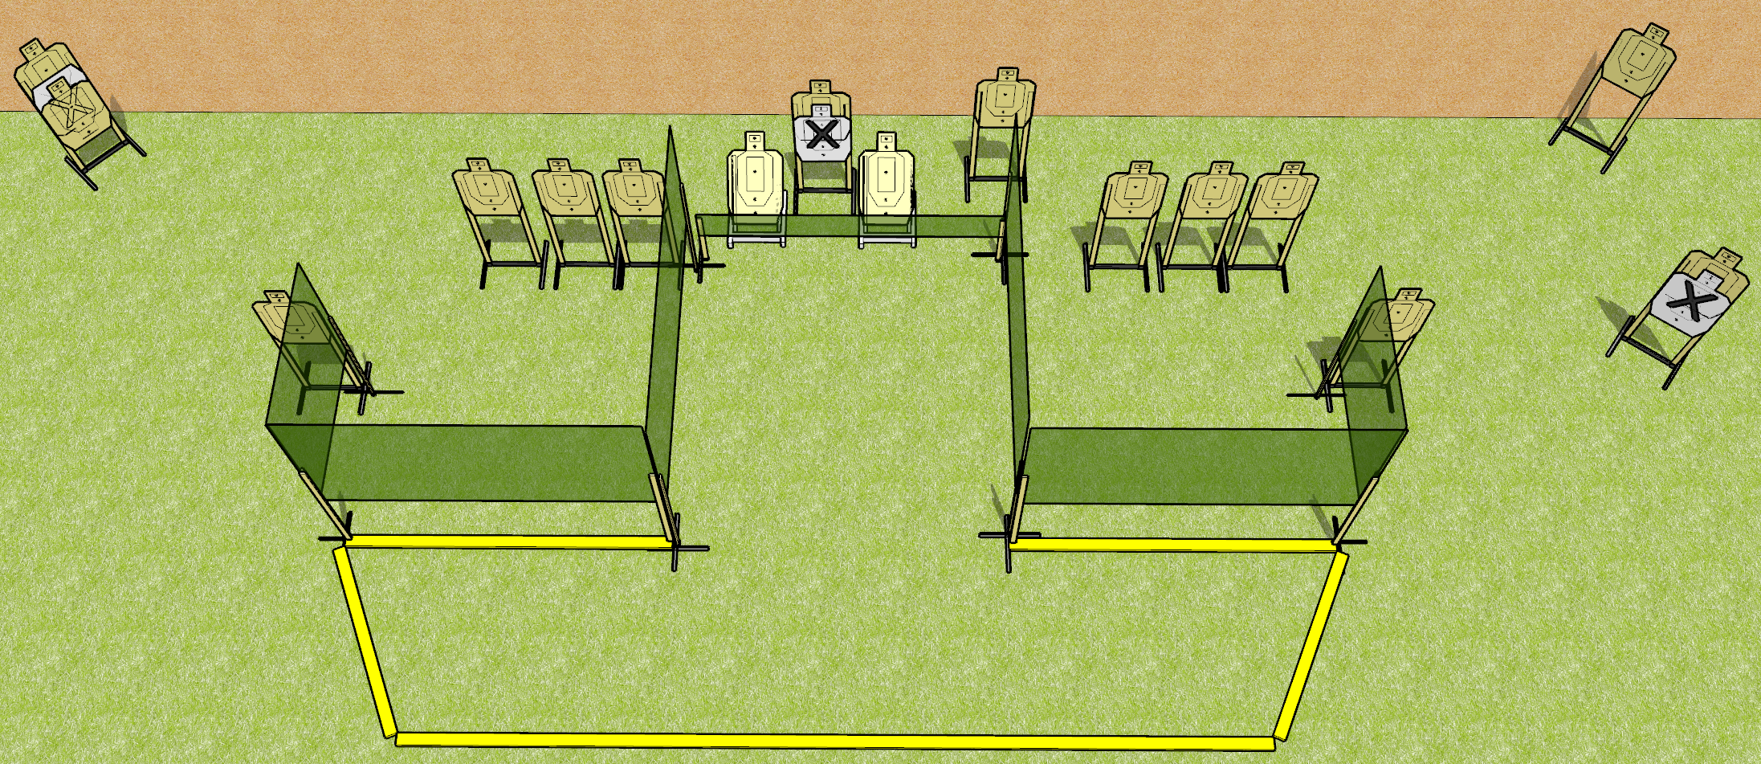
 | Dothan Gun Club – USPSA Match Low Hose Course Designer : Drew Coleman
Round Count 32 rounds 16 USPSA
Equipment List 8 wall feet 19 USPSA targets

Slide 2
Low Hose
Written Stage Briefing
Low Hose is a 32 round, 160 point, Comstock course of fire. There are 16 USPSA targets. The best 2 hits on paper will score. The start signal is audible.
The space under the walls marked by fault lines are ports.
Handgun start position is inside the shooting area, wrists below belt. Handgun is loaded and holstered.
PCC start position is inside the shooting area, stock on belt. Loaded carbine is held with both hands, safety on.
On start signal, engage targets as they become available from within the shooting area.

